Slide 1
File Handling and Templates

Slide 2
Streams
In C++, a stream means a flow of data.
Data moves from program to output device OR from input device to program
Think of it like a pipe carrying data
Types of Streams
Input Stream → Data comes INTO program Output Stream → Data goes OUT of program
Example
cin → input stream (keyboard → program)
cout → output stream (program → screen)

Slide 3
Stream | Meaning | Use
cin | Standard Input | Take input
cout | Standard Output | Print output
cerr | Standard Error | Display error
clog | Buffered error | Log messages
Standard Streams in C++
C++ provides some predefined streams:

Slide 4
Class | Purpose
istream | Input stream
ostream | Output stream
iostream | Both input & output
ifstream | File input
ofstream | File output
fstream | File input + output
Stream Classes in C++
All streams are part of C++ Standard Library.
Main Classes – refer left table

Slide 5
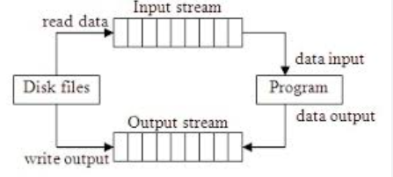
File Streams
When we work with files, data flows between:
Program ↔ File
This is called File Stream
i.e. A file stream is used to read data from a file or write data into a file.
Header File for File Handling
Before using file streams:
#include <fstream>
This library provides classes for file handling.
Notes:
Instead of:
Keyboard → cin
Screen → cout
We use files like:
input.txt
output.txt

Slide 6
File Stream Classes
1. ifstream (Input File Stream) - Used to read data from file.
2. ofstream (Output File Stream) - Used to write data to file.
3. fstream (Input + Output) - Used for both reading and writing.

Slide 7
Opening a file
Opening a file means connecting your program with a file so that you can:
Read data from it
Write data into it
Until you open a file → you cannot access it

Slide 8
Ways to Open a File
There are 2 main ways:
1. Open File Using Constructor
File opens at the time of object creation
Syntax:
ClassName object_name("filename", mode);
Example –
#include <iostream>
#include <fstream>
using namespace std;
int main() {
ifstream fin("data.txt", ios::in);
if (fin.is_open()) {
cout << "File opened successfully";
} else {
cout << "Error opening file";
}
fin.close();
}
Notes:
is_open()
Checks whether file opened successfully – retutn true or false accordingly
close() – closes the file – so that any resource allocated to it will get free.

Slide 9
File Opening Modes –
Modes tell how the file will be used
Mode | Full Name | Purpose | Data Flow | Important Points
ios::in | Input Mode | Read data from file | File → Program | File must exist, otherwise error
ios::out | Output Mode | Write data to file | Program → File | Creates file if not exists, overwrites existing data
ios::app | Append Mode | Add data at end of file | Program → File | Old data is not deleted, always writes at end
ios::trunc | Truncate Mode | Clear file before writing | Program → File | Deletes all previous content
ios::binary | Binary Mode | Work with binary data | Both | Used for non-text files (images, videos, etc.)
Notes:
ios::binary (Binary Mode) - Used to handle binary files (non-text)
Data is stored in binary format
Example:
Images
Videos
Executable files
ios::trunc alone → only clears file ios::out + ios::trunc → clears + writes

Slide 10
Combining Modes
Use | operator
ios::in | ios::out
Example:
fstream file("data.txt", ios::in | ios::out);
Default Modes
Example:
ifstream fin("data.txt"); // automatically ios::in ofstream fout("data.txt"); // automatically ios::out
Class | Default Mode
ifstream | ios::in
ofstream | ios::out
fstream | No fixed default (specify mode)

Slide 11
2. Open File Using open() Function – First create object, then open file.
Syntax:
file_object.open("filename", mode);
Example –
#include <iostream>
#include <fstream>
using namespace std;
int main() {
ifstream fin;
fin.open("data.txt", ios::in);
if (fin.is_open()) {
cout << "File opened successfully";
} else {
cout << "Error opening file";
}
fin.close();
}

Slide 12
File Reading
In C++, file reading is done using:
ifstream (input file stream)
Basic Steps for Reading a File
Create object of ifstream
Open the file
Read data
Close file

Slide 13
Example 1: Reading Word by Word
#include <iostream>
#include <fstream>
using namespace std;
int main() {
ifstream fin("data.txt");
if (fin.is_open()) {
string word;
while (fin >> word) {
cout << word << endl;
}
fin.close();
} else {
cout << "File could not be opened!";
}
}
"data.txt" must exist in same folder OR give full path:
ifstream fin("C:\\Users\\Rohit\\Desktop\\data.txt");
fin >> word
Reads until space, tab, newline
Automatically stops at EOF
Notes:
>> → extraction operator (used to read data)
fin >> word - Read one word from file and store in word
while (fin >> word) - Keep looping until reading fails

Slide 14
Example 2: Reading Line by Line
#include <iostream>
#include <fstream>
using namespace std;
int main() {
ifstream fin("data.txt");
if (fin.is_open()) {
string line;
while (getline(fin, line)) {
cout << line << endl;
}
fin.close();
} else {
cout << "Error opening file!";
}
}
Why this is better?
Reads full line (including spaces)
Used in logs, CSV, real-world files

Slide 15
Example 3: Reading Character by Character
#include <iostream>
#include <fstream>
using namespace std;
int main() {
ifstream fin("data.txt");
if (fin.is_open()) {
char ch;
while (fin.get(ch)) {
cout << ch;
}
fin.close();
} else {
cout << "File not opened!";
}
}

Slide 16
Example 4: Reading Numbers
#include <iostream>
#include <fstream>
using namespace std;
int main() {
ifstream fin("numbers.txt");
if (fin.is_open()) {
int num;
while (fin >> num) {
cout << "Read: " << num << endl;
}
fin.close();
} else {
cout << "Unable to open file!";
}
}

Slide 17
eof() –
eof() means End Of File
fin.eof()
Returns:
true → end of file reached
false → still data available
eof() becomes true ONLY AFTER a read fails
How File Reading Actually Works (Step-by-Step)
Suppose file content is:
A B C
EOF is detected after failure, not before
Step | Operation | Result | eof()
1 | Read A | Success | false
2 | Read B | Success | false
3 | Read C | Success | false
4 | Try to read next | ❌ FAIL | true

Slide 18
Wrong Way of Using eof()
ifstream fin("data.txt"); if (fin.is_open()) { string word; while (!fin.eof()) { fin >> word; cout << word << endl; } fin.close(); }
Why This is Wrong?
Because:
Loop checks eof() first
Then tries to read
Last iteration → read fails
But loop already entered
So invalid data gets printed
Notes:
Example Problem
File:
Hello World
Output:
Hello World World duplicate

Slide 19
Why eof() is NOT Recommended
Problems:
Checks EOF too late
Causes extra iteration
May print duplicate or garbage data
Correct Way (Best Practice)
Use the read operation itself as condition
Example 1: Word Reading
ifstream fin("data.txt");
if (fin.is_open()) {
string word;
while (fin >> word) {
cout << word << endl;
}
fin.close();
}

Slide 20
Example 2: Line Reading
ifstream fin("data.txt"); if (fin.is_open()) { string line; while (getline(fin, line)) { cout << line << endl; } fin.close(); }
Example 3: Character Reading
ifstream fin("data.txt"); if (fin.is_open()) { char ch; while (fin.get(ch)) { cout << ch; } fin.close(); }
Notes:
Why This Works Perfectly
Because:
These functions return true/false
Condition Meaning
Success Continue loop
Fail / EOF Stop loop
So no extra iteration happens

Slide 21
When Should You Use eof()? (Correct Usage)
eof() is NOT for loop control
It is used for checking state AFTER reading
Example: Detect EOF After Loop
ifstream fin("data.txt");
if (fin.is_open()) {
string word;
while (fin >> word) {
cout << word << endl;
}
if (fin.eof()) {
cout << "Reached end of file";
}
fin.close();
}

Slide 22
File Writing
Writing means storing data into a file instead of printing on screen.
We use:
#include <fstream>
Main class:
ofstream // output file stream
Basic Steps for Writing
Create ofstream object
Open file
Write data
Close file

Slide 23
Example 1: Basic Writing
#include <iostream> #include <fstream> using namespace std; int main() { ofstream fout("data.txt"); if (fout.is_open()) { fout << "Hello World"; fout.close(); } else { cout << "File not opened!"; } }
If file does NOT exist → it is created
If file exists → it is overwritten (default)

Slide 24
Writing Multiple Lines
ofstream fout("data.txt"); if (fout.is_open()) { fout << "Line 1" << endl; fout << "Line 2" << endl; fout << "Line 3" << endl; fout.close(); }
Writing Different Data Types
ofstream fout("data.txt"); if (fout.is_open()) { int age = 25; float salary = 50000.5; fout << "Age: " << age << endl; fout << "Salary: " << salary << endl; fout.close(); }
Works like cout

Slide 25
Writing Using Variables
ofstream fout("data.txt"); if (fout.is_open()) { string name = "Rohit"; fout << "Name: " << name; fout.close(); }

Slide 26
Using ios::app (Append Mode)
ofstream fout("data.txt", ios::app); if (fout.is_open()) { fout << "New line added" << endl; fout.close(); }
Behavior
Old data remains New data is added at end

Slide 27
Using ios::trunc
ofstream fout("data.txt", ios::trunc); if (fout.is_open()) { fout << "Old data deleted, new data written"; fout.close(); }
ios::trunc:
Deletes previous content
Starts fresh
Note -
ofstream fout("data.txt", ios::trunc);
provided only trunc, but:
ofstream automatically adds:
ios::out bc out is the default

Slide 28
Exampels –
1 - User Input → Write to File (Append Mode)
#include <iostream>
#include <fstream>
using namespace std;
int main() {
ofstream fout("data.txt", ios::app);
if (!fout.is_open()) {
cout << "Error opening file!";
return 0;
}
string line;
cout << "Enter a line: ";
getline(cin, line);
fout << line << endl;
cout << "Data written successfully!" << endl;
fout.close();
}
Notes:
Takes input from user Adds it at end of file (no deletion)

Slide 29
2 - Writing Multiple Lines Using Loop
#include <iostream>
#include <fstream>
using namespace std;
int main() {
ofstream fout("data.txt");
if (!fout.is_open()) {
cout << "Error opening file!";
return 0;
}
for (int i = 1; i <= 5; i++) {
fout << "This is line " << i << endl;
}
cout << "5 lines written successfully!" << endl;
fout.close();
}
Notes:
Writes 5 lines
Old data gets deleted (default mode)

Slide 30
Writing Multiple User Inputs (Loop)
#include <iostream>
#include <fstream>
using namespace std;
int main() {
ofstream fout("data.txt", ios::app);
if (!fout.is_open()) {
cout << "Error opening file!";
return 0;
}
int n;
cout << "How many lines do you want to enter? ";
cin >> n;
cin.ignore(); // to clear newline from buffer
string line;
for (int i = 1; i <= n; i++) {
cout << "Enter line " << i << ": ";
getline(cin, line);
fout << line << endl;
}
cout << "All lines written successfully!" << endl;
fout.close();
}
Note - cin.ignore() is needed before getline()

Slide 31
Writing Structured Data (Table Format)-
#include <iostream>
#include <fstream>
using namespace std;
int main() {
ofstream fout("employees.txt");
if (!fout.is_open()) {
cout << "Error opening file!";
return 0;
}
fout << "Name\tAge\tSalary" << endl;
fout << "Rohit\t25\t50000" << endl;
fout << "Amit\t30\t60000" << endl;
fout << "Neha\t28\t55000" << endl;
cout << "Employee data written successfully!" << endl;
fout.close();
}

Slide 32
Writing Mixed Data Types –
#include <iostream>
#include <fstream>
using namespace std;
int main() {
ofstream fout("student.txt");
if (!fout.is_open()) {
cout << "Error opening file!";
return 0;
}
string name = "Rohit";
int age = 22;
float marks = 88.5;
fout << "Name: " << name << endl;
fout << "Age: " << age << endl;
fout << "Marks: " << marks << endl;
cout << "Student data written!" << endl;
fout.close();
}

Slide 33
File Pointers
When you open a file, C++ maintains positions (pointers) inside the file.
These pointers decide:
From where to read
From where to write

Slide 34
Pointer | Used For | Function
get pointer (g) | Reading | seekg(), tellg()
put pointer (p) | Writing | seekp(), tellp()
Types of File Pointers
There are two pointers:

Slide 35
tellg() → Get Current Read Position
fin.tellg()
Returns current position of get pointer
Example 1: tellg()
#include <iostream> #include <fstream> using namespace std; int main() { ifstream fin("data.txt"); if (!fin.is_open()) { cout << "File not opened!"; return 0; } char ch; fin.get(ch); // read 1 char cout << "Position: " << fin.tellg() << endl; fin.get(ch); // read next char cout << "Position: " << fin.tellg() << endl; fin.close(); }
Notes:
Output:
Position: 1 Position: 2

Slide 36
tellp() → Get Current Write Position
fout.tellp()
Returns position of put pointer
Example 2: tellp()
#include <iostream> #include <fstream> using namespace std; int main() { ofstream fout("data.txt"); if (!fout.is_open()) { cout << "Error!"; return 0; } fout << "Hello"; cout << "Position: " << fout.tellp() << endl; fout << " World"; cout << "Position: " << fout.tellp() << endl; fout.close(); }

Slide 37
seekg() → Move Read Pointer
fin.seekg(position);
Moves get pointer
Example 3: seekg()
#include <iostream> #include <fstream> using namespace std; int main() { ifstream fin("data.txt"); if (!fin.is_open()) { cout << "Error!"; return 0; } char ch; fin.seekg(6); // move to index 6 fin.get(ch); cout << ch << endl; // prints character at position 6 fin.close(); }

Slide 38
seekp() → Move Write Pointer
fout.seekp(position);
Moves put pointer
Example 4: seekp()
#include <iostream> #include <fstream> using namespace std; int main() { ofstream fout("data.txt"); if (!fout.is_open()) { cout << "Error!"; return 0; } fout << "Hello World"; fout.seekp(6); // move to position 6 fout << "C++"; fout.close(); }
Notes:
Hello C++ld

Slide 39
seek with Direction
You can move pointer relative to:
Example 5: seekg with direction
ifstream fin("data.txt"); if (fin.is_open()) { char ch; fin.seekg(2, ios::beg); // from beginning fin.get(ch); cout << ch << endl; fin.seekg(-1, ios::end); // last character fin.get(ch); cout << ch << endl; fin.close(); }
Flag | Meaning
ios::beg | from beginning
ios::cur | from current
ios::end | from end

Slide 40
Important Concept
Positions are in bytes
So:
1 char = 1 byte
int/struct may take more

Slide 41
Using fstream (Read + Write Together)
#include <iostream>
#include <fstream>
using namespace std;
int main() {
fstream file("data.txt", ios::in | ios::out);
if (!file.is_open()) {
cout << "Error!";
return 0;
}
file.seekp(0);
file << "Hi";
file.seekg(0);
char ch;
file.get(ch);
cout << ch;
file.close();
}

Slide 42
Types of Files in C++
Type | Meaning
Text Files | Store data in readable form
Binary Files | Store data in machine (raw) form
In C++, files are mainly of 2 types:

Slide 43
Text Files
Data is stored as characters (human-readable)
Example content:
Name: Ajay Age: 25 Salary: 50000
Features of Text Files
Human readable
Easy to edit (Notepad, VS Code)
Data stored as characters
Slower (due to conversion)

Slide 44
Binary Files
Data is stored in raw binary form (0s and 1s)
Example (not readable):
0101010100110101...
Features of Binary Files
Not human readable
Faster (no conversion)
Compact storage
Used for structures, images, etc.

Slide 45
Example: Writing to Binary File
#include <iostream>
#include <fstream>
using namespace std;
int main() {
ofstream fout("data.bin", ios::binary);
if (!fout.is_open()) {
cout << "Error!";
return 0;
}
int num = 100;
fout.write((char*)&num, sizeof(num));
fout.close();
}
Notes:
1. Opening File
ofstream fout("data.bin", ios::binary);
ofstream → used for writing "data.bin" → binary file ios::binary → IMPORTANT
Without this → file treated as text With this → raw bytes stored
fout.write((char*)&num, sizeof(num)); -
&num
Gives address of variable
Example:
num = 100 Address = 1000 (assume)
(char*)&num
Convert address to char*
Why?
Because:
write() expects pointer to bytes
char* = pointer to 1 byte So file writes byte-by-byte
sizeof(num)
Number of bytes to write
For int:
sizeof(int) = 4 bytes (usually)
fout.write((char*)&num, sizeof(num));
“Take 4 bytes from memory starting at address of num and write them into file”

Slide 46
Example Reading from binary file –
#include <iostream>
#include <fstream>
using namespace std;
int main() {
ifstream fin("data.bin", ios::binary);
if (!fin.is_open()) {
cout << "Error!";
return 0;
}
int num;
fin.read((char*)&num, sizeof(num));
cout << num;
fin.close();
}
Notes:
in.read((char*)&num, sizeof(num));
Meaning:
“Read 4 bytes from file and store them into memory of num”

Slide 47
Important Rules for Binary Files -
1. Same Data Type Rule
If you write float → you must read float
If you write int → you must read int
Otherwise → garbage value
2. Same Order Rule
Data must be read in the same order as written
Example:
Write: int → float → char
Read: int → float → char
If order changes → wrong output
3. String Caution
Do NOT write string directly
Use char[] instead

Slide 48
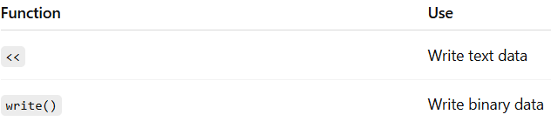
Sequential vs Random Access –
Sequential Access
Data is read/written in order (one after another) You cannot skip directly
Like reading a book from page 1 → 2 → 3
Random Access
You can jump to any position directly
Like opening page 50 directly
I/O Functions for Sequential Access -
Used for normal reading/writing

Slide 49
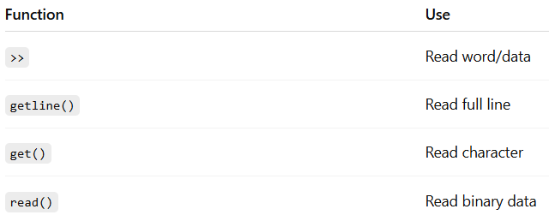
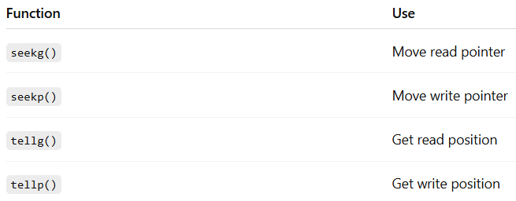
Reading Functions
I/O Functions for Random Access -
Used with file pointers

Slide 50
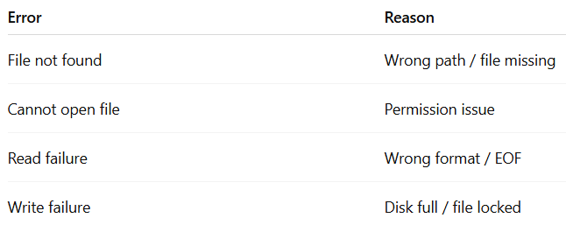
Error Handling –
File Error handling means: detecting and handling problems while working with files.
Common File Errors –

Slide 51
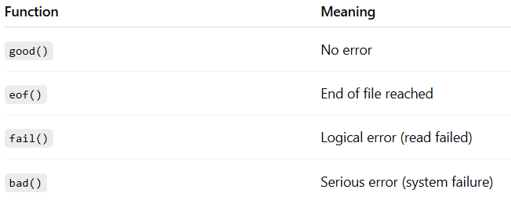
Basic Error Handling –
Using is_open()
ifstream fin("data.txt"); if (!fin.is_open()) { cout << "File not opened!"; return 0; }
This is the first and most important check
Stream State Functions
C++ provides functions to check file state:

Slide 52
Example: Using fail()
#include <iostream> #include <fstream> using namespace std; int main() { ifstream fin("data.txt"); if (!fin.is_open()) { cout << "Error opening file!"; return 0; } int num; fin >> num; if (fin.fail()) { cout << "Error: Invalid data!"; } fin.close(); }

Slide 53
Example: Using eof()
ifstream fin("data.txt"); if (fin.is_open()) { int num; while (fin >> num) { cout << num << endl; } if (fin.eof()) { cout << "End of file reached"; } fin.close(); }
Used after reading, not in loop

Slide 54
Example: Using bad()
ifstream fin("data.txt"); if (fin.bad()) { cout << "Serious error occurred!"; }
Rare, but used for hardware/system failure
Example: Using good()
ifstream fin("data.txt"); if (fin.good()) { cout << "File is ready to use"; }

Slide 55
Combined Error Handling (Best Practice) –
#include <iostream>
#include <fstream>
using namespace std;
int main() {
ifstream fin("data.txt");
if (!fin.is_open()) {
cout << "File not opened!";
return 0;
}
int num;
while (fin >> num) {
cout << num << endl;
}
if (fin.eof()) {
cout << "Reached end of file";
} else if (fin.fail()) {
cout << "Data format error";
} else if (fin.bad()) {
cout << "Serious error";
}
fin.close();
}

